Slide 1
RockBuster Stealth LLC Market Analysis By Graham Field 08.02.2024

Slide 2
Streaming service launch strategy
RockBuster LLC Stealth is a movie rental company that is looking to expand its service to online streaming.
Considering that movie rental have shifted away from physical copies to digital platform such as apps and websites. Rock Buster faces some competition with already existing and successful services such as Netflix, Amazon and Disney to name a few
Rock Buster already has existing movie rental licences and is primed to enter the market and be competitive.

Slide 3
Key Questions
Which movies contributed the most/least to revenue gain?
What was the average rental duration for all videos?
Which countries are Rockbuster customers based in?
Where are customers with a high lifetime value based?
Do sales figures vary between geographic regions?

Slide 4
Project analysis slide 3
Areas of Analysis
Summary Statistics
Geographic analysis
Rating Analysis
Top customer Analysis
Genre Analysis
Where RockBusters customers are located and where the revenue is the highest globally.
Where RockBusters customers are located and where the revenue is the highest globally
Which NCPP ratings are the most popular
Who and where are RockBusters top customers. What does a top customer look like.
What kind of movie are people watching the most

Slide 5
Summary Statistics
1,000 Movies
599 Unique Customers
$61,312.04 in Total Revenue for 2006.
17 Movie Genres
6 Languages (English is highest revenue generating.)
Operations in 109 Countries
Ave. Rental = 4.99 days
Min. Rental = 3 Days
Max. Rental = 7 Days
Ave. Rental Rate = $2.98
Min Rental Rate = $0.99
Max Rental Rate = $4.99
Replacement Costs Min. = $9.99 Max. = $29.99

Slide 6
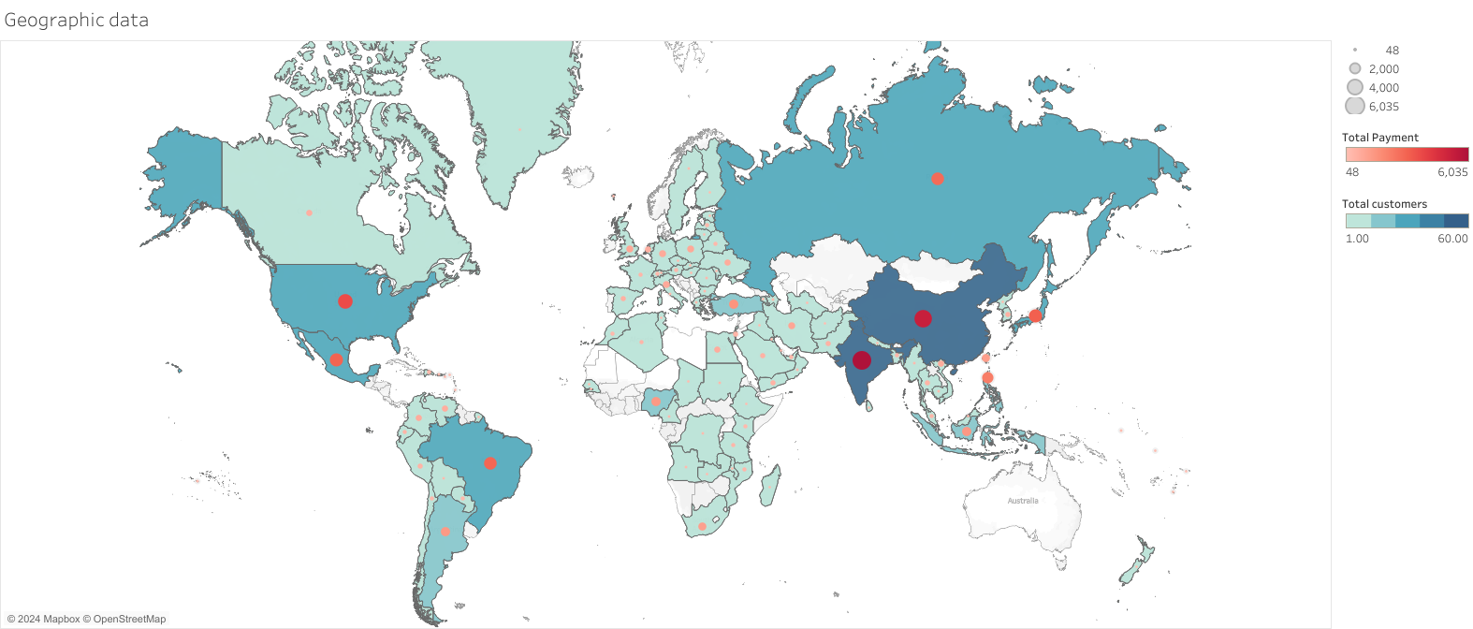
Global Overview of customers and revenue

Slide 7
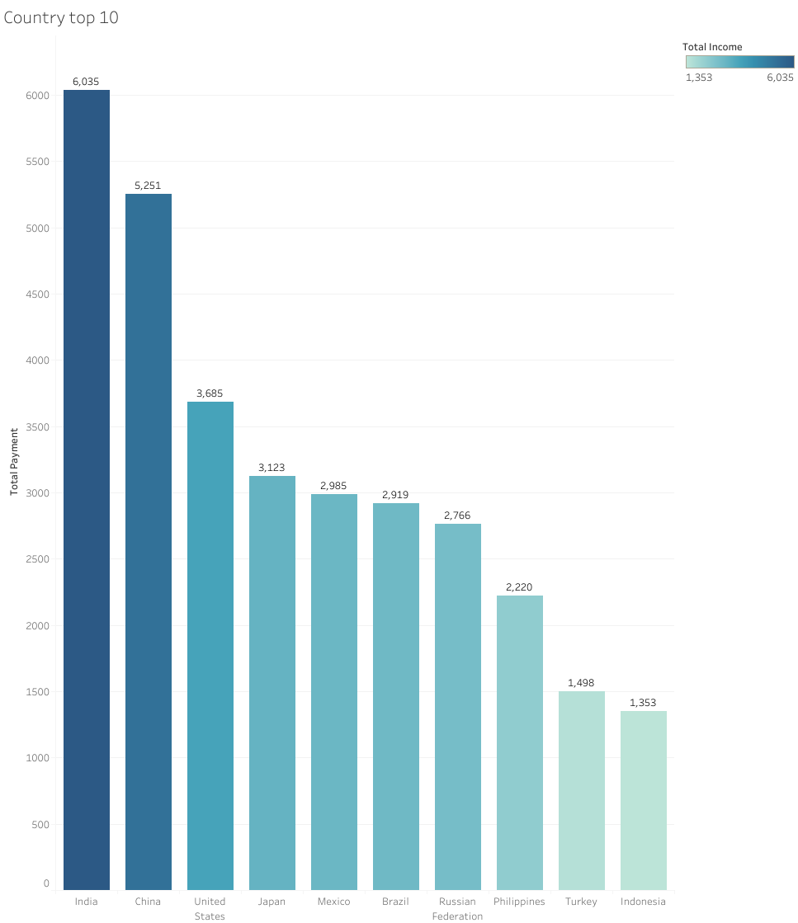
Top 10 Countries
From this we can see the top 10 countries, the top 3 are India, China and The United States.
India is nearly double what The United States is with $6035.00

Slide 8
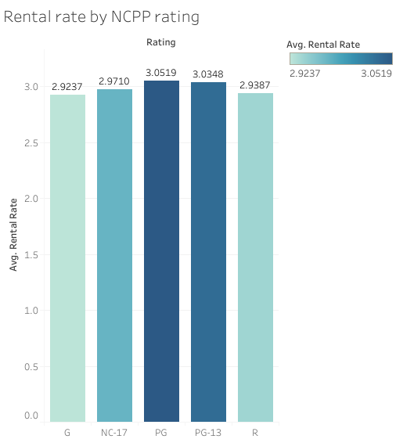
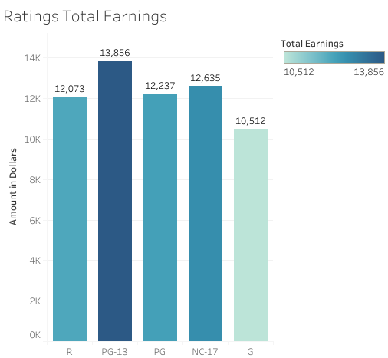
The rental rate by rating is fairly consistent across all ratings how ever PG is the most popular
PG 13 has the highest total earnings from any of the ratings

Slide 9
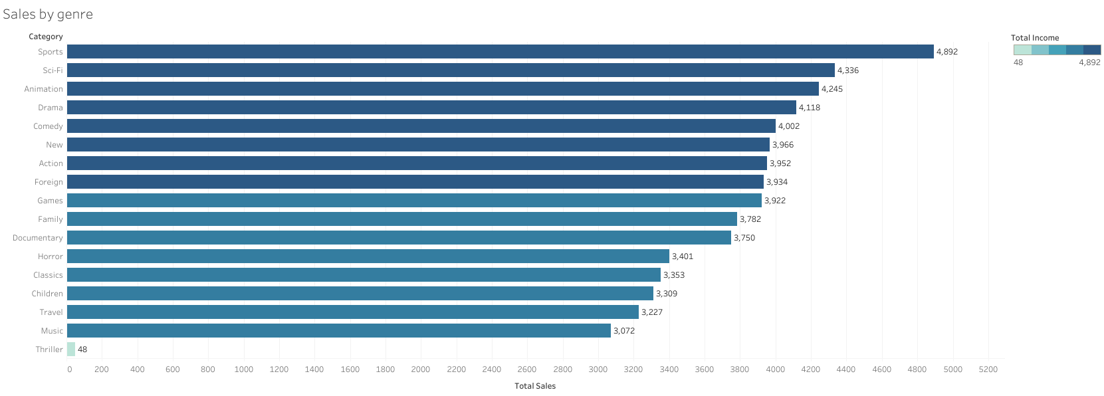
Sports is the highest earning genre, this is certainly something to consider as no other streaming platform offers sports at the moment. Thriller seems to have done very badly and should probably not be considered with too much enthusiasm

Slide 10
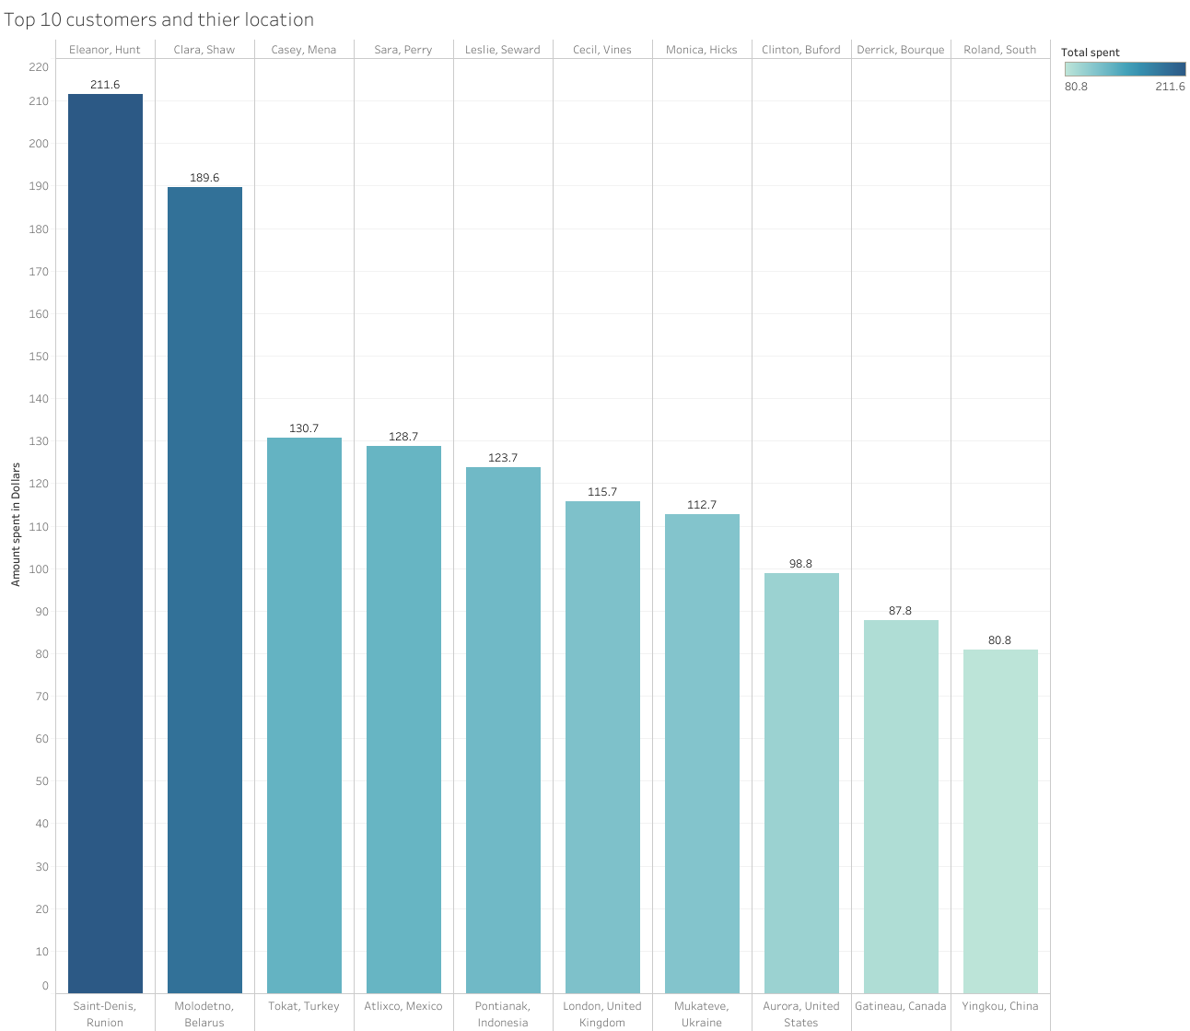
Top 10 Global Customers
There is very wide spread of customers across the world. There doesn’t really seem to be anyone country that stands out in terms of top customers.
Looking at how much people are ultimately willing to spend, I would recommend some kind of loyalty program to incentivize higher spending.

Slide 11
Conclusions
Recommendations
The streaming service should be rolled out in the top countries first.
PG-13 Products should be prioritized for release first.
The top genres should be promoted and maybe even produced first.
Develop a customer reward program fro top spenders and an incentive program to get more people spending
India, China and The US have are the largest markets
PG-13 Films are the highest grossing
Sports, SC-FI and Animation are the most popular Genres
Customers are willing to spend hundreds of dollars on entertainment

Slide 12
Thank You

